Slide 1
Predicting Wine Quality with Machine Learning: Addressing Feature Sensitivity and Class Imbalance
Authors:
1. Okello Andrew Peters 2024/HD05/21944U
2. Nalikka Joan Deborah
2024/HD05/26060U
Presented by – Andrew & Joan
Affiliation: Makerere University
Uganda

Slide 2
Introduction
The wine industry is a major global market, valued not only for its cultural and economic contributions but also for the intricate art and science behind wine production. Wine quality is a critical determinant of market success, as it influences pricing, branding, consumer preference, and overall reputation. Traditionally, quality assessment has relied on sensory evaluation by sommeliers, which, while effective, is time-consuming, costly, and inherently subjective. In recent years, data-driven methods such as machine learning (ML) have gained attention as promising alternatives that can provide consistent, objective, and scalable solutions for predicting wine quality.

Slide 3
Background
The wine industry’s rapid growth has intensified the need for reliable and efficient quality assessment techniques. Quality is typically assessed based on attributes like taste, aroma, and appearance—characteristics that trained professionals can evaluate subjectively. While sensory evaluation remains essential, it presents limitations when used as the primary method of quality control.
Notes:
The dataset can be found here.

Slide 4
Literature Review
Chemical Composition and Wine Quality: Research demonstrates a correlation between certain chemical properties—such as alcohol, acidity, and phenolic compounds—and perceived wine quality. [1] found that higher alcohol and balanced acidity levels are often associated with superior quality ratings, providing a foundation for ML models to utilize these attributes in classification tasks.
Machine Learning Models in Wine Quality Prediction: [2] made significant advancements by applying data mining techniques to wine quality prediction, using models like decision trees and ensemble methods (e.g., Random Forests).
Feature Engineering and Data Preprocessing: Effective feature engineering and data preprocessing are crucial to improving model accuracy. Santos et al. (2020) highlighted the significance of selecting relevant attributes such as flavonoids and total phenols, which can enhance model predictive power. Peng et al. (2019) also noted that less commonly explored attributes, such as magnesium, may impact wine classification results.
Notes:
The dataset can be found here.

Slide 5
Gaps in Related work
Feature Interaction and Sensitivity Analysis.
Outlier and Noise handling.
3. Class imbalance.
4. Model Scalability and Validation.

Slide 6
Problem Statement
The primary challenge in this study is to accurately classify wine quality into predefined categories using chemical properties. Traditional quality assessments rely on sensory evaluation, which is limited by subjectivity and cost.
Machine learning models offer a promising alternative, but they must overcome issues related to feature interaction, outlier management, and class imbalance to ensure accuracy and fairness in predictions. This study seeks to identify the most influential features, evaluate the effectiveness of various ML models, and address imbalanced quality classes to create a reliable wine quality prediction model.

Slide 7
Significance of the Project
This study holds significant implications for the wine industry, machine learning research, and consumer satisfaction.
Industry impact
Advancement of ML in quality Assessment
Consumer Satisfaction

Slide 8
ML Research Objectives
To identify key physiochemical features.
To develop and compare classification models.
To address class imbalance.
To evaluate model effectiveness and reliability.

Slide 9
Research Questions
How do chemical properties of wine, such as alcohol content, phenolic compounds, and color intensity, influence the classification of wine into specific classes?
Which machine learning model (e.g., Random Forest, Support Vector Machine, or logistic regression) provides the highest accuracy in classifying wine based on its chemical properties?
Which features (e.g., Alcohol, Flavanoids, Proline) are the most influential in determining wine class, and how does removing or adjusting these features impact model performance?
How does the model’s performance change when techniques for handling class imbalance, such as SMOTE or class weighting, are applied?
How well does the model generalize to new, unseen data, and what are the potential pitfalls of overfitting in this specific wine classification problem?

Slide 10
Dataset Description
This dataset contains 178 entries of wine samples, each characterized by 13 chemical features and labeled with a target class. The features include:
Alcohol: Alcohol content in the wine.
Malic Acid: Amount of malic acid.
Ash: Ash content.
Alcalinity of Ash: Alkaline property of the ash.
Magnesium: Magnesium content.
Total Phenols: Total phenolic compounds.
Flavanoids: Flavonoid compounds.
Nonflavanoid Phenols: Phenolic compounds not classified as flavonoids.
Proanthocyanins: A class of polyphenols.
Color Intensity: Intensity of the wine's color.
Hue: Hue of the wine.
0D280/0D315 of Diluted Wines: Measure related to wine dilution.
Proline: Proline amino acid content.

Slide 11
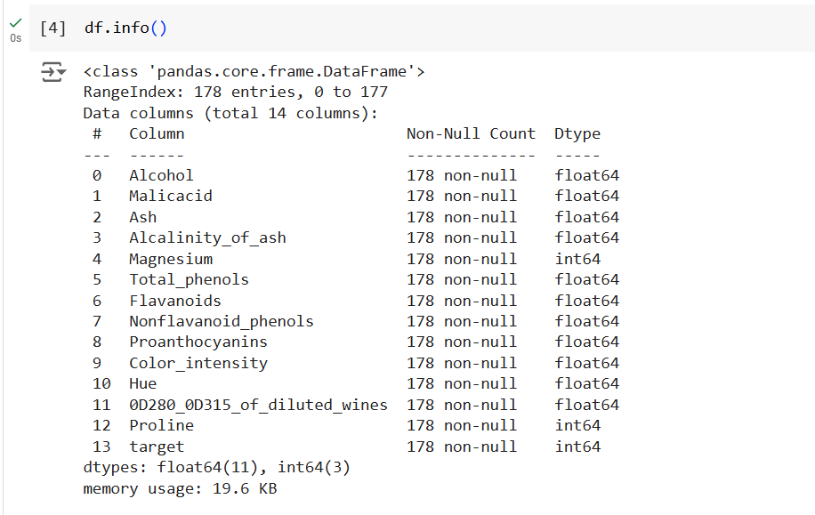
Dataset Features and Shape
The Dataset has 178 records and 14 features

Slide 12
Methodology
Data
.
Exploratory Data Analysis
Exploration
cleaning
Data Visualisation
Feature Engineering
Processed data
Logistic Regressor
Random Forest Classifier
Random Forest Classifier with class weights
SVM with class weights
XGBoost classifier
Explainability for our models

Slide 13
Data Cleaning and Preprocessing
Data Collection
The study uses a wine recognition dataset containing 178 entries and 13 chemical attributes, such as alcohol, malic acid, and color intensity.
Data Preprocessing
Missing Values: The dataset contains no missing values, making it suitable for direct modeling.
Duplicate Handling: No duplicates were detected.
Data types: There was no categorical data.

Slide 14
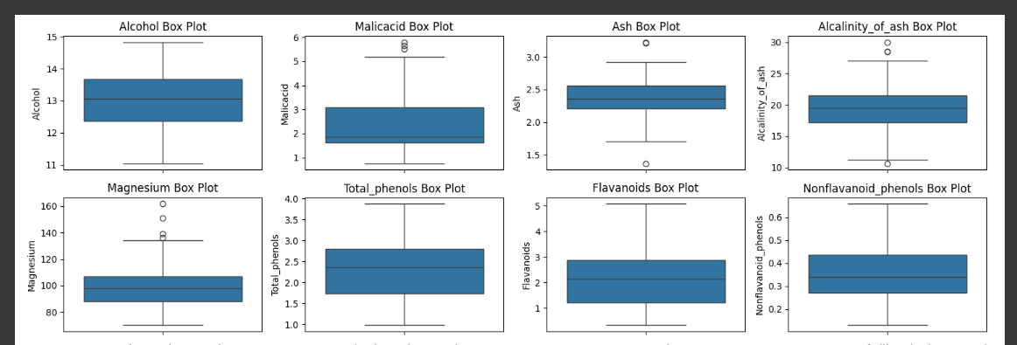
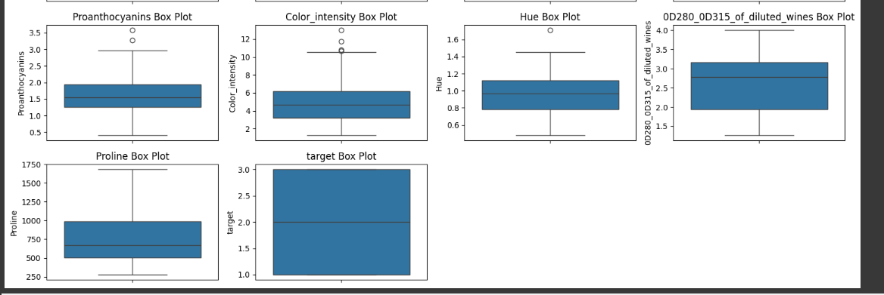
Outliers

Slide 15
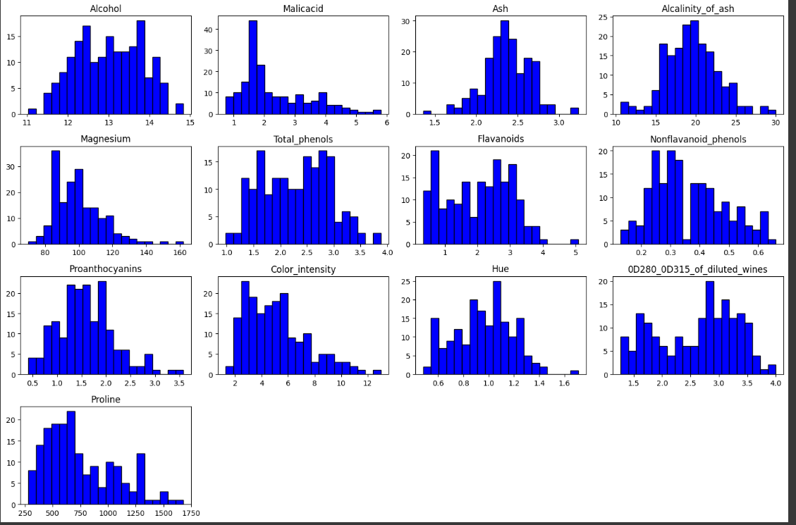
Univariate Analysis Visualisation

Slide 16
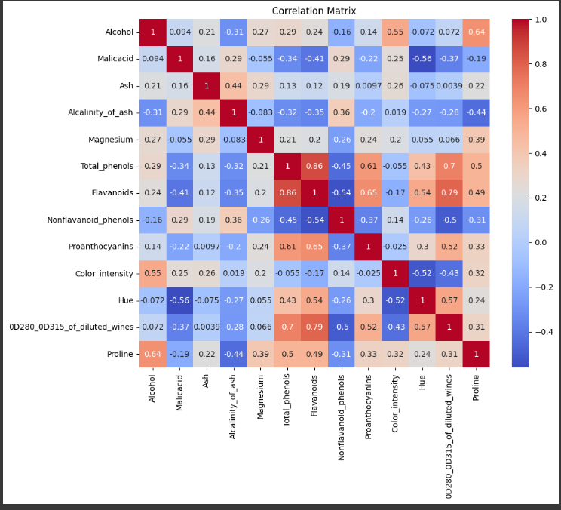
Bivariate Analysis
Insights:
We had strong negative, moderate negative, strong positive, moderate positive and no correlations:

Slide 17
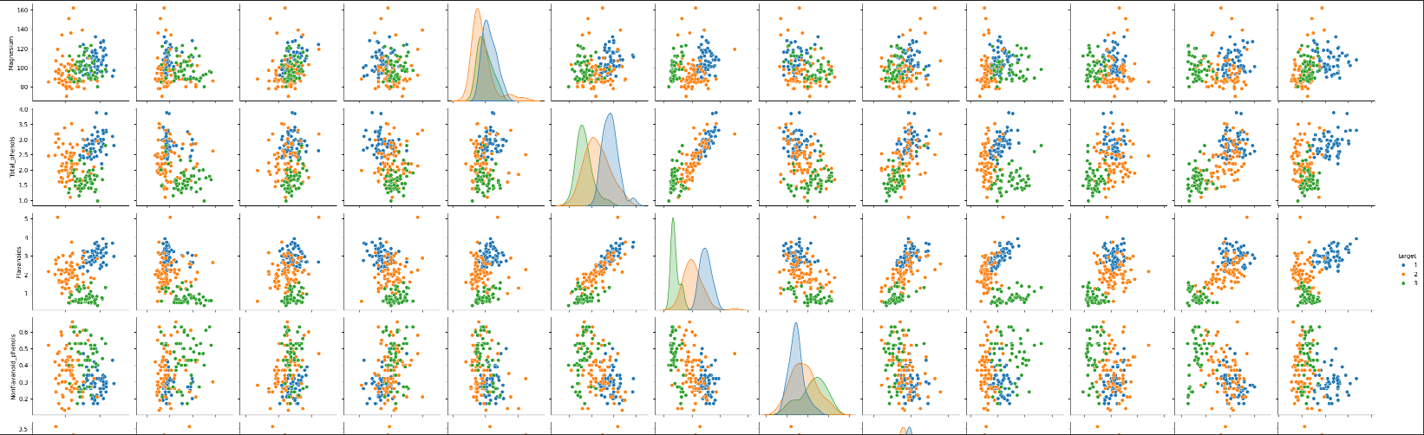
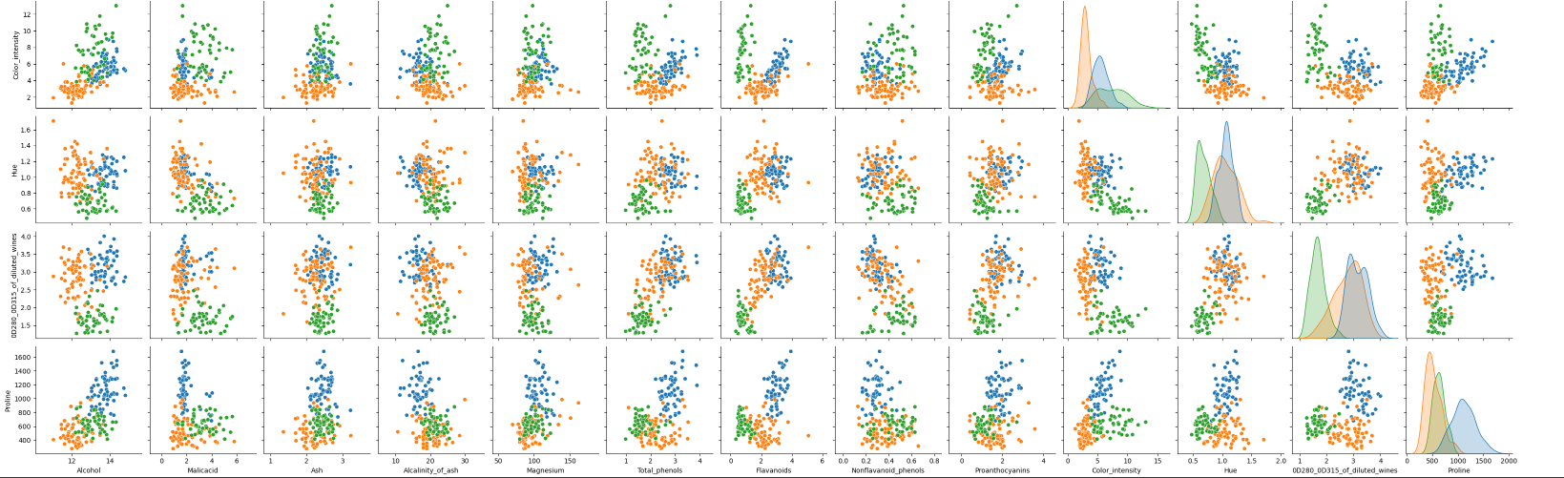
Multivariate Analysis

Slide 18
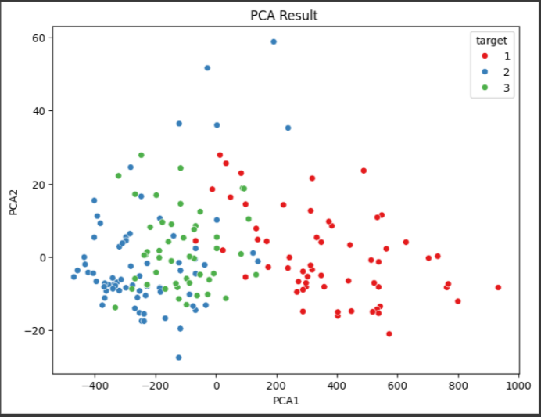
Multivariate Analysis
Insights
There is clear separation between class 1 and the other classes. However, class 2 and class 3 show overlap which indicate that they have similar characteristics compared to class 1.

Slide 19
MODEL RESULTS
Model | Class | Precision | Recall | F1-score
Logistic Regression (lr) | class 1 | 1.00 | 1.00 | 1.00
 | class 2 | 1.00 | 1.00 | 1.00
 | Class 3 | 1.00 | 1.00 | 1.00
Random Forest classifier | class 1 | 0.95 | 1.00 | 0.97
 | class 2 | 1.00 | 0.96 | 0.98
 | Class 3 | 1.00 | 1.00 | 1.00
Random Forest with class weights | class 1 | 0.95 | 1.00 | 0.97
 | class 2 | 1.00 | 0.96 | 0.98
 | class 3 | 1.00 | 1.00 | 1.00

Slide 20
Model Results
Model | Class | Precision | Recall | F1-score
SVM with class weights | class 1 | 0.73 | 0.89 | 0.80
 | class 2 | 0.71 | 0.52 | 0.60
 | Class 3 | 0.56 | 0.61 | 0.58
XGBoost classifier | class 1 | 1.00 | 0.93 | 0.96
 | class 2 | 0.88 | 1.00 | 0.93
 | Class 3 | 1.00 | 0.88 | 0.93

Slide 21
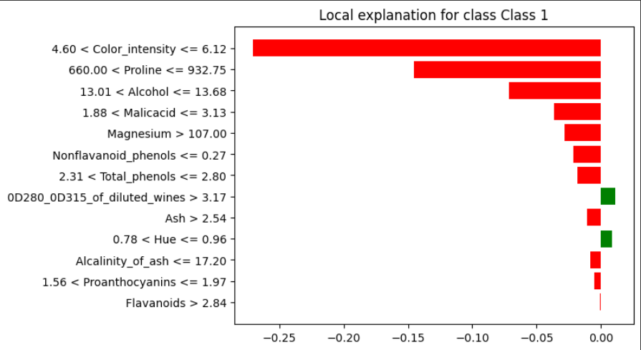
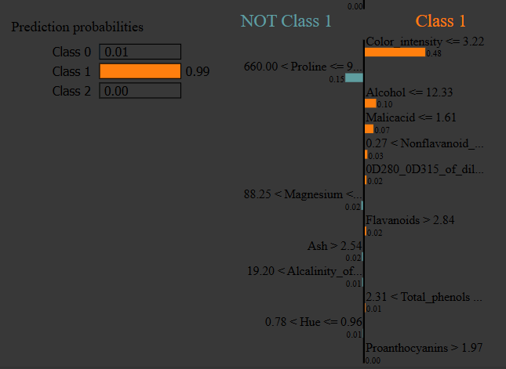
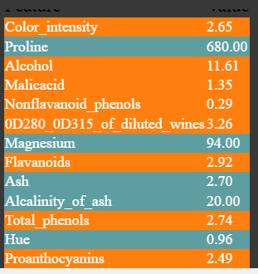
Explainable AI
XGBOOST with Lime
Red shows positive features for class 1
Green shows opposing features.

Slide 22
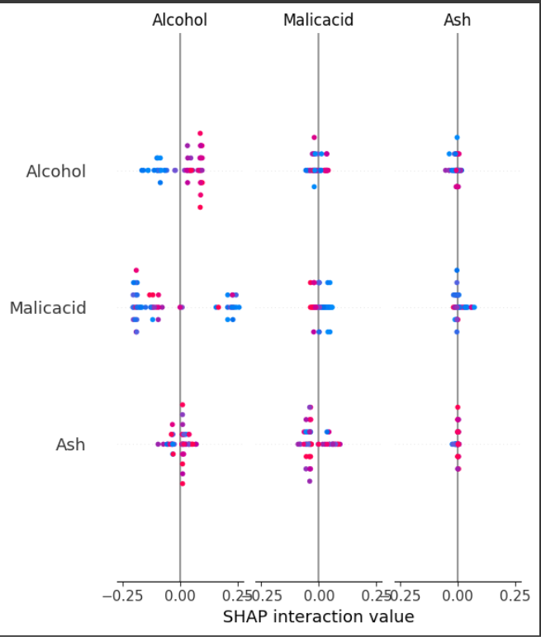
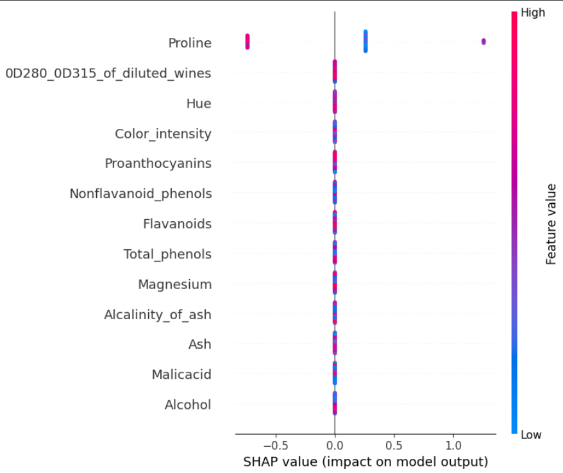
Explainable AI.
Random Forest Classifier: Support Vector Machine:

Slide 23
Future Works:
Model Refinement
Dataset expansion
Advanced interpretability
Deployment considerations

Slide 24
References
[1]Cortez, P., Cerdeira, A., Almeida, F., Matos, T., \& Reis, J. (2009). Modeling wine preferences by data mining from physicochemical properties. Decision Support Systems
[2] Gonzalez, A., et al. (2021). "Chemical composition analysis and quality prediction in wine: A machine learning approach." Journal of Wine Research
[3] Santos, D., et al. (2020). "Feature engineering in wine quality prediction: An analysis of physicochemical attributes." Food Ǫuality and Preference.
[4] Peng, C., Andersen, B., Arshid, S., Larsen, M. R., Albergaria, H., Lametsch, R., et al. (2019). Proteomics insights into the responses of Saccharomyces cerevisiae during mixed-culture alcoholic fermentation with Lachancea thermotolerans. FEMS Microbiol. Ecol. 95:fiz126. doi: 10.1093/femsec/fiz126

